Slide 1
Stochastic Energy Systems with Mechanism Choices
Jingze Dai, McMaster University
Research Supervisor: Dr.Douglas Down

Slide 2
Table of contents
01
02
03
04
05
06
Introduction
Problem Environment
Objectives
Background information of the energy system
The concrete problem this project aims to solve
The final destination of this problem’s solutions
Methodology
Analysis
Conclusions
Methods used to solve this problem
Experimental results and their meanings
The final summarized results

Slide 3
01
Introduction
Energy System Fundamentals

Slide 4
Background
Energy systems of consumer communities
An energy system used for supplying energy to a group of energy consumer entities, all energy consumptions are in a First-In-First-Out order.
Examples of Such energy systems
e.g., power plant of an apartment, where each room requires energy supply equally.
Two parts of energy systems’ cost origins
1. Energy consumption spending (More energy consumption, more cost)
2. Energy supply congestion spending (More waiting supplies, most cost)

Slide 5
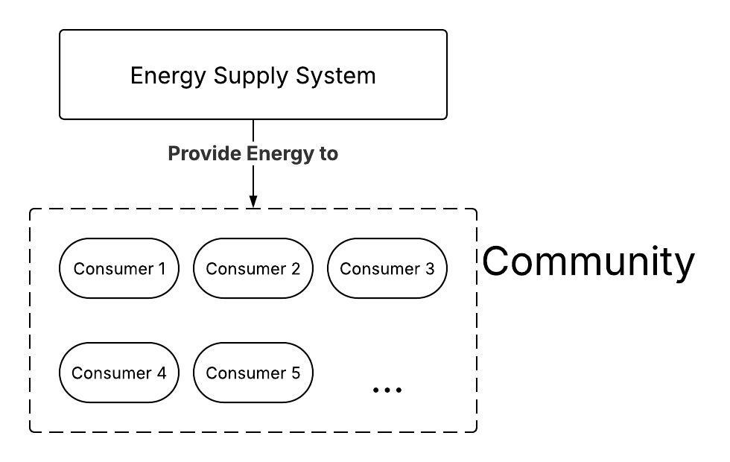
Fig 1 – Sample of Energy Systems

Slide 6
Engineer’s Parallel Goals
Goal 1: To minimize energy consumption
Goal 2: To minimize waiting

Slide 7
02
Problem Environment
Energy System Concrete Problems’ Settings

Slide 8
On usual cases:
1. The energy system is a continuous time Markov chain (CTMC), where job arrivals follow a Poisson distribution, whose parameter is a constant.
2. The energy system will not service the arrived jobs (that is, when the server is OFF) until the waiting job amount reaches k1, where k1 >= 1. Then the system will turn on with γ (the turn-on rate).
3. When the waiting job amount < k2, the system uses the normal processing rate (μ), otherwise when it >= k2, the system will use the enhanced process rate (μ).

Slide 9
On usual cases:
4. In order to make the whole system under stable and expected performance, λ < μ < μ.
5. α is the idle rate of the energy system, available on 1 of 2 conditions. (Mentioned on slide 11)
6. Remember γ (the turning-on rate) and α (the idle rate) also exist, both are greater than 0.
7. will_turn_off represents the ability to turn off. If it is true, then α > 0, or it is 0. -> (the system cannot turn off)

Slide 10
On usual cases:
8. 1 <= k1 <= k2, as the enhanced service rate only occurs after normal service rate (represents overload). Note that both k1 and k2 can reach infinity.
9. Important: parameters k1, k2, and will_turn_off are variables (can be adjusted by system controls), while others are all constant (cannot be changed).

Slide 11
will_turn_off determines distinctions
1. When will_turn_off = False, the energy system will never go back to OFF states (to become idle), so we can ignore all states without service processing. This results in a variant M/M/1 queue (Two service rates).
2. When will_turn_off = True, the energy system will go back to idle when there is no waiting job. This has more complicated structures, and it does not belong to any special CTMC cases (e.g., M/M/1).

Slide 12
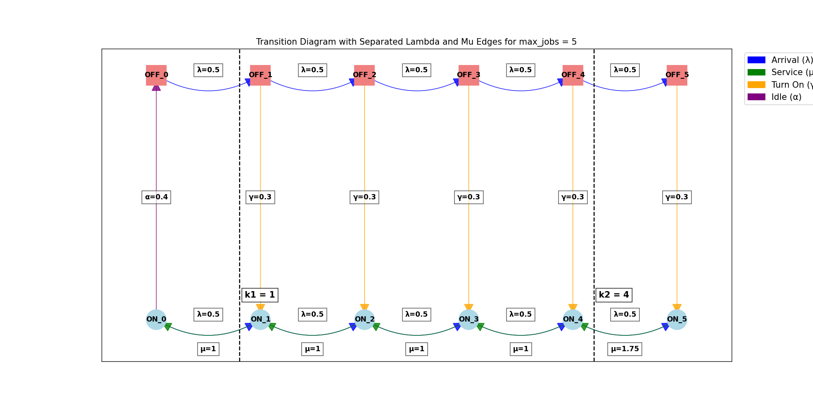

Slide 13
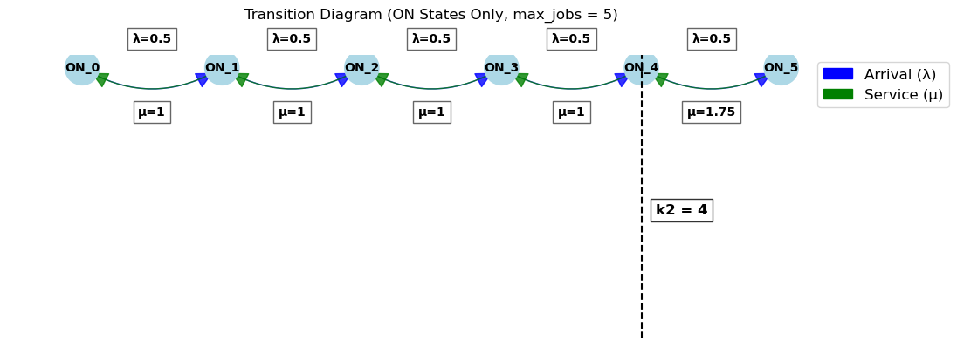

Slide 14
Power Consumption and Total Cost
1. Power consumption = Sum of (each state’s steady-state probability * power consumption coefficient)
2. Power consumption coefficient:
0 for OFF states when the system is not turning on, 1 for OFF turning-on states. σ for ON0, 1 for ON states with the regular service rate, and (μ)^2 for ON states with the enhanced service rate.
3. The idle power consumption coefficient σ is greater than 0 and less than 1.

Slide 15
Total Cost
1. Expected Number of Jobs (Mean) = Sum of (each state’s steady-state probability * the waiting jobs)
2. ON0 means 0 waiting jobs, ON1 means 1, and so on…
1. Total_Cost = Power Consumption * β + Expected Number of Jobs.
2. β is a constant weight parameter, greater than 0.

Slide 16
03
Objectives
Problems’ solution objectives

Slide 17
Solved Question 1
Our goal is to minimize the Total Cost of the whole energy system. Previously there are two choices:
1. Maximize k2 value, which aims not to use the enhanced service rate.
2. Setting will_turn_off = True. (Allowing turning off)
3. Setting will_turn_off = False. (Disallowing turning off)
Question: Can 1 and 2, or 1 and 3, co-exist in the optimal parameter group?

Slide 18
Solved Question 2
Question 2 is a variant problem of Question 1:
1. Parameter k2 is a non-polarized value, which means it is neither maximized nor minimized.
2. Setting will_turn_off = True.
3. Setting will_turn_off = False.
Question: Can 1 and 2, or 1 and 3, co-exist in the optimal parameter group?

Slide 19
04
Methodologies
Methods used to solve these problems

Slide 20
Key – Solving CTMC
1. Both cases can be modelled as CTMC (continuous-time Markov chain), so the method of solving CTMC balanced equations can be used.
2. After getting equations of all states’ steady-state probability, we can determine the overall system’s equation of energy consumption and # of Jobs, which determines the total cost.
3. By discovering the k2 derivative of such system’s total cost, we can find local max/min positions (optimal k2).

Slide 21
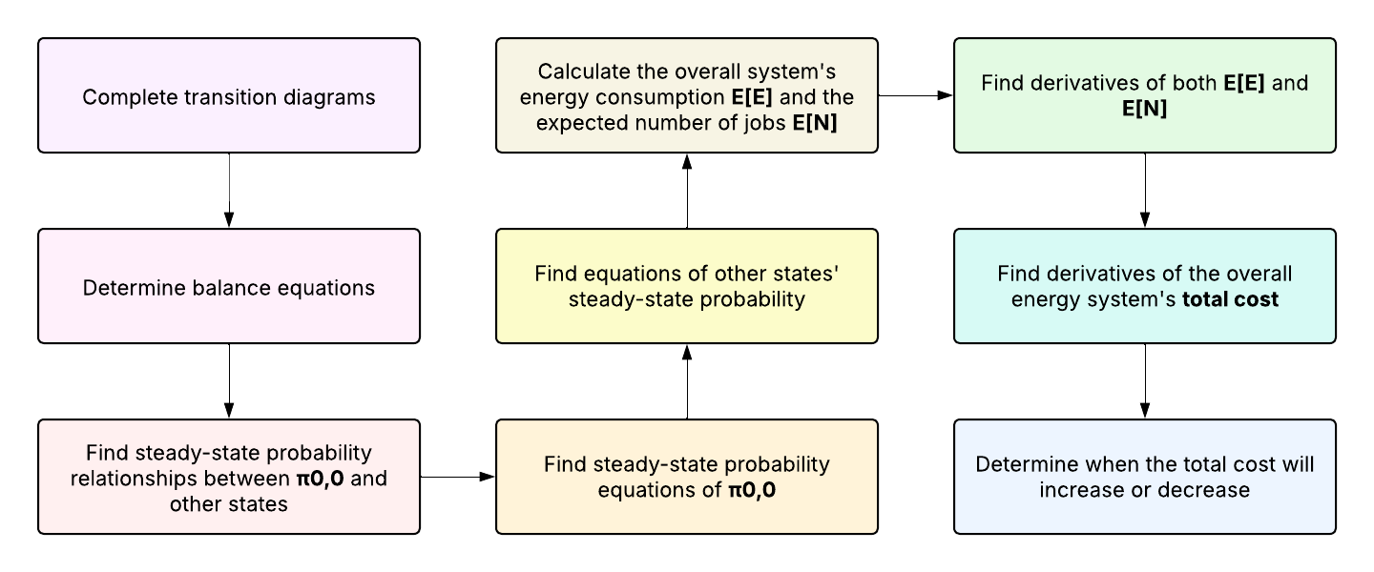
Mandatory Processes

Slide 22
Step 1 – Complete Transition Diagrams
1. Listed all states on both conditions.
π0, x represent OFF states. (e.g., π0, 4 represents when the system is OFF, with 4 waiting jobs)
π1, x represent ON states. (e.g., π1, 2 represents when the system is ON, with 2 waiting jobs)
2. Determine all states’ transmission rates and targets (λ, μ, μ, γ, α)
3. Draw transition diagrams on both will_turn_off conditions.

Slide 23
Step 2 & 3 – Solving Balance Equations
1. For each state, find all IN and OUT rates, and summarize them to an equation between two nearby states’ steady-state probability.
2. Solve these equations, to get relationships between different states’ steady-state probability.
3. By substitutions, find all other states’ steady-state probability equations with π0, 0.

Slide 24
Step 4 – Determine the Formula of π0, 0
Now all other states can be expressed by (…) * π0, 0.
By adding them together, we have:
(Net Term) * π0, 0 = 1.
So π0, 0 will equal 1/(Net Term).
Reminder: Whatever the system’s parameters change, π0, 0 will always be positive.

Slide 25
Step 5 – Determine the Formula of states
From Step 3, we already have the relationship equation of different formulas between each other state and π0, 0.
e.g., (…) * π0, 2 = (…) * π0, 0.
By substituting π0, 0 and transforming the formula, we can get equations of all other states. E.g., π0, 2 = (…)/(…) <- here π0, 0, are already substituted.

Slide 26
Step 6 – Determine E[E] and E[N]
To calculate the expected jobs E[N]:
E[N] = sum of {each state’s steady-state probability * its corresponding number of jobs}
e.g., π1, 0 has the steady-state probability of 0.3, and its expected number of jobs is 0, so therefore its expected number of jobs is 0.3 * 0 = 0.
Formulas of E[E] is given already on slide 14.

Slide 27
Step 7 – Find Derivatives
Some interesting things exist on both E[E] and E[N]:
1. They have the same denominator, because both of them are calculated from π0, 0
2. On both numerator side, a lot of terms look similar, since there are a lot of common terms inside.

Slide 28
Step 7 – Find k2 Derivatives
First use the quotient rule, and then simplify both sides’ numerator terms.
(No need to simplify the denominator terms. Since by the quotient rule, both E[E] and E[N] derivative’s denominator is D^2, where D is the denominator of E[E])

Slide 29
Step 8 – Find total_cost and its Derivatives
From slide 15, we already know total cost = E[E] * β + E[N], where β is the weight coefficient (always > 0).
Substitute the total cost functions with actual equations of E[E] and E[N]. On the numerator side, a lot of terms can be combined or cancelled.

Slide 30
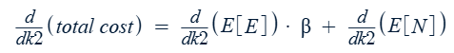
Step 9 – Find total cost’s k2 Derivatives
From slide 15, we already know total cost = E[E] * β + E[N], where beta is the weight coefficient (always > 0).
Considering beta as an abstract constant, then we have the total cost’s k2 derivative her:

Slide 31
Step 9 – Find total cost’s k2 Derivatives
With such k2 derivative, now we are able to find when it will be positive (total cost is increasing), and when it will be negative (total cost is decreasing).
We can also determine the energy system’s optimal k2 values on both conditions.

Slide 32
Formal Proof (on both sub-conditions’ solving)
Both conditions have considered three cases independently:
1. β is a very small value, meaning only E[N] is important for determining the total cost’s values and tendencies.
2. β is a very large value, meaning only E[E] is important for determining the total cost’s values and tendencies.
3. β is a balanced value, meaning both E[E] and E[N] are important for determining the total cost’s values and tendencies.

Slide 33
05
Analysis
Experimental results

Slide 34
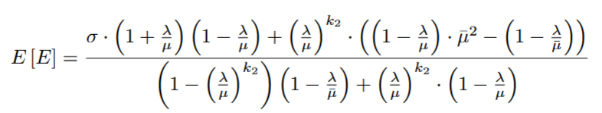
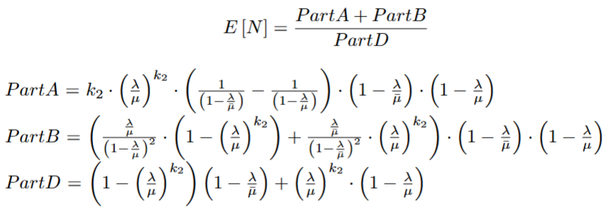
Case A – will_turn_off = False

Slide 35
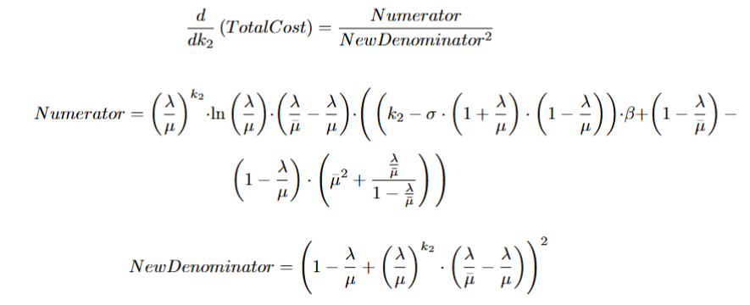
Case A – will_turn_off = False

Slide 36
Case A – will_turn_off = False
Problem 1 solution: Yes, 1 and 3 can co-exist in the optimal parameter group.
Observations:
1. Maximum k2 minimizes E[E] but maximizes E[N], and will_turn_off = False increase E[E]
2. However, a small k1 value can lower E[N] and offset the effects of the maximum k2.

Slide 37
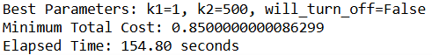
Case A – will_turn_off = False
Evidence:
λ = 0.2, μ = 1, μ = 10000, γ = 0.5, α = 0.5, σ = 0.5, β = 1.

Slide 38
Case A – will_turn_off = False
Problem 2 solution: Yes, 1 and 3 can co-exist in the optimal parameter group.
Observations:
1. On slide 32 case 1 & 2, the k2 derivative of total cost is continuously positive or negative, which means a non-polarized k2 value cannot exist as an optimal parameter.
2. However, on case 3, the k2 derivative of total cost is first negative then positive, allowing non-polarized k2 vals.

Slide 39
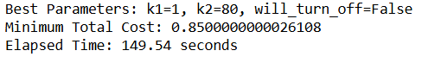
Case A – will_turn_off = False
Evidence:
λ = 0.2, μ = 1, μ = 100, γ = 0.5, α = 0.5, σ = 0.5, β = 1.

Slide 40
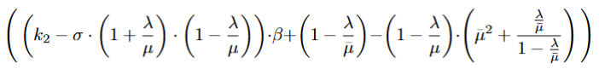
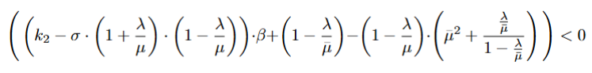
Case A – Methods to find optimal k2 values
There are several terms in the k2 derivative of total cost, but only one term possible to change sign:
So, we need to solve:

Slide 41
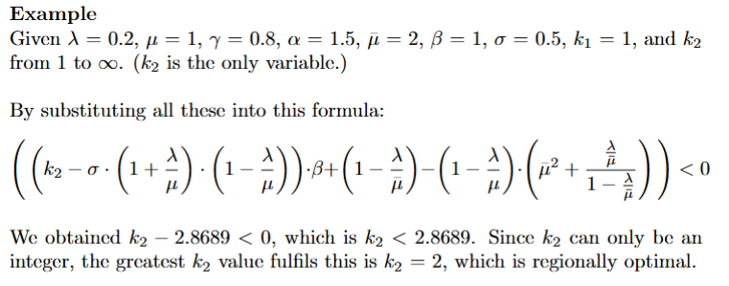
Case A – Methods to find optimal k2 values

Slide 42
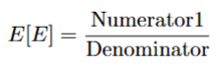
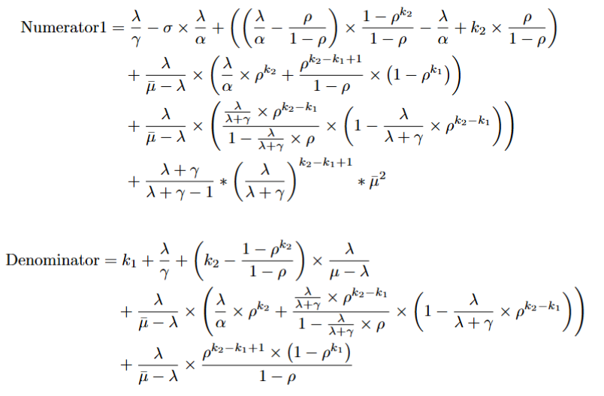
Case B – will_turn_off = True

Slide 43
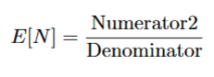
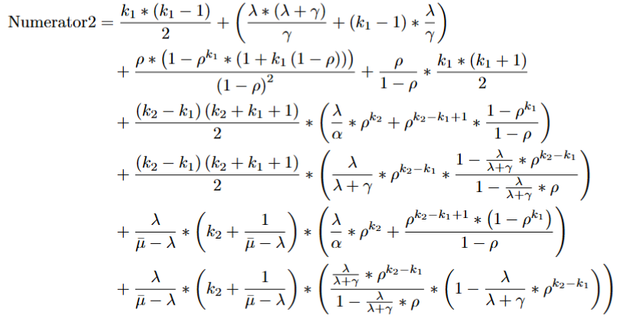
Case B – will_turn_off = True
The denominator of E[N] is the same as E[E].

Slide 44
Case B – will_turn_off = True
Formulas of the k2 derivative of total cost is available at:
https://www.overleaf.com/read/rpbgzbfpsktm#65aff2

Slide 45
Case B – will_turn_off = True
Problem 1 solution: Yes, 1 and 2 can co-exist in the optimal parameter group.
Observations:
1. Selecting higher idle rates and turn-on rates trigger preferences on will_turn_off = True
2. Parameter μ and μ are significant on determining the total cost actual values, but they are trivial in making preferences on will_turn_off options.

Slide 46
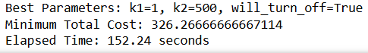
Case B – will_turn_off = True
Evidence:
λ = 0.5, μ = 1, μ = 17.5, γ = 1.5, α = 1.5, σ = 0.5, β = 500.

Slide 47
Case B – will_turn_off = True
Problem 2 solution: Yes, 1 and 2 can co-exist in the optimal parameter group.
Observations:
1. On slide 32 all three cases, there exists cases allowing the non-polarized k2 value to exist as optimal.
2. To have such solutions, parameter λ should have a small value (lambda <= 10 % of μ)

Slide 48
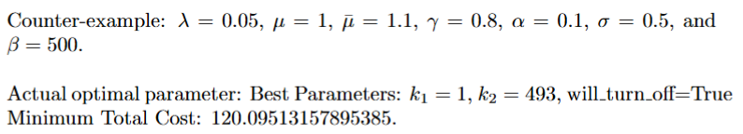
Case B – will_turn_off = True
Case 1 Evidence:

Slide 49
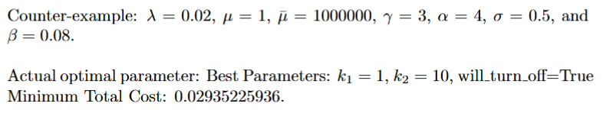
Case B – will_turn_off = True
Case 2 Evidence:

Slide 50
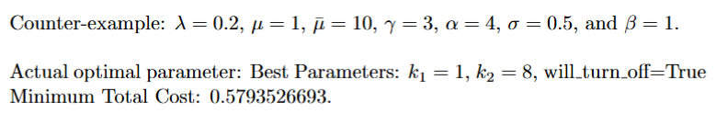
Case B – will_turn_off = True
Case 3 Evidence:

Slide 51
06
Conclusions
Final Conclusions

Slide 52
Conclusions
1. Non-polarized k2 values exist on all conditions’ most cases. This means selecting polarized k2 values may not always contributes to optimal total cost.
2. Interesting discoveries: although these non-polarized k2 values exist, larger k2 values don’t have a much larger total cost (their differences are negligible)

Slide 53


End of Presentation

